Slide 1



Data Analytics in Business
EFIMM0141
Stock Price Prediction
Instructor: Dr. Aniekan Essien
Group 3
Note: Image adapted from “How Options Traders Played Apple Stock Before Big Event”.
October 31st, 2024

Slide 2
Agenda
Data Preparation
Part 2
Results and Analysis
Part 4
Introduction
Part 1
Models
Part 3
Conclusion
Part 5

Slide 3
01 Introduction
Company Background, Project Overview, Market Insights

Slide 4

Company Background & Project Overview
Apple Inc.
Overview of Apple Inc.
Founded in 1976, Cupertino, California
Known for iPhone, iPad, Mac
Business Challenge
Forecast stock prices to guide financial planning
Project Objective
Predict Apple Inc. (AAPL) stock prices using historical
data and technical indicators
Image Source: The Brand Hopper, 2023. Innovate, Integrate, Dominate: Success Factors of Apple Inc. Available at: https://thebrandhopper.com/2023/11/27/innovate-integrate-dominate-success-factors-of-apple-inc/ (Accessed: 29 October 2024)
Notes:
Hi I’m Xiying Huang. I’m also a data scientist in our group. And I will introduce LSTM and MoE model briefly.
For LSTM, based on the result from EDA, we selected these four variables as input. Then we applied a function to separately scaled input and target variables to maintain stability in training and ensure consistent output.

Slide 5
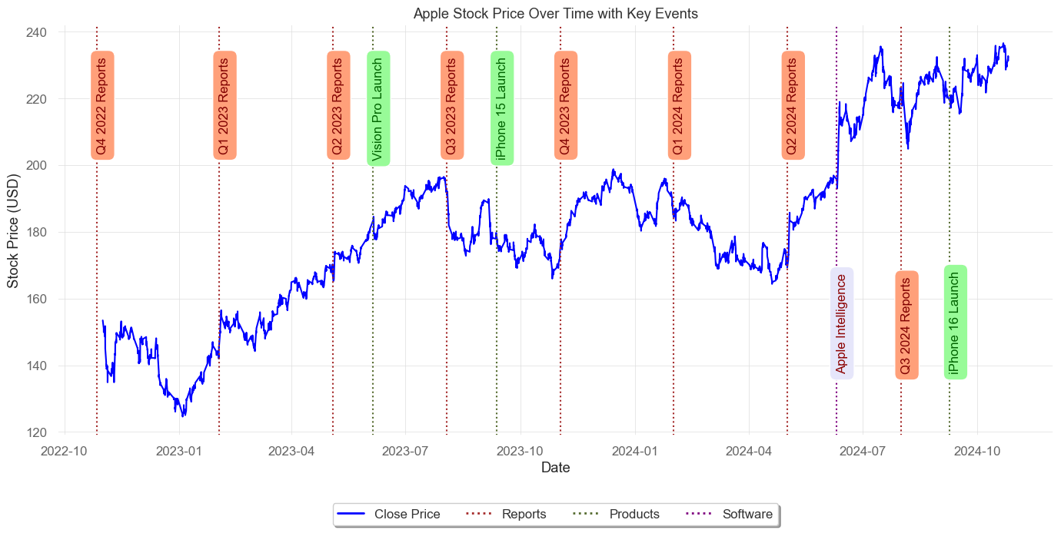
Methodology, Data & Market Insights
Methodology
Models used- LSTM, ARIMA, MoE
Data Source
Yahoo Finance- 2 years of hourly stock data
Evaluation Metrics
Accuracy- MAE, RMSE, MAPE
Market Position
Stock price rose from $151 to $231
iPhone sales = 50% of revenue; services grew 10% annually
Notes:
Hi I’m Xiying Huang. I’m also a data scientist in our group. And I will introduce LSTM and MoE model briefly.
For LSTM, based on the result from EDA, we selected these four variables as input. Then we applied a function to separately scaled input and target variables to maintain stability in training and ensure consistent output.

Slide 6
02 Data Preparation
Data Preparation, EDA, Data Processing

Slide 7
Data Preparation
Technical Indicators
Variable Name | Indicator Name | Purpose | Calculation
RSI | Relative Strength Index | Overbought/Oversold | 0-100; avg gains/losses over 14 periods
ADX | Average Directional Index | Trend Strength | 0-100; higher values = stronger trend
ATR | Average True Range | Volatility | Based on the "True range" of price changes over 14 periods
BB_width | Bollinger Bands Width | Volatility/Breakouts | (Upper - Lower Band) / Middle Band
VWAP | Volume Weighted Average Price | Fair Price by Volume | Cumulative sum of (Volume * Avg Price) / Cumulative Volume
IMI | Intraday Momentum Index | Intraday Momentum | Intraday gains vs. losses over 14 periods
Note: True Range is the max of: 1) High - Low, 2) High - Previous Close, 3) Low - Previous Close
Notes:
Hi I’m Xiying Huang. I’m also a data scientist in our group. And I will introduce LSTM and MoE model briefly.
For LSTM, based on the result from EDA, we selected these four variables as input. Then we applied a function to separately scaled input and target variables to maintain stability in training and ensure consistent output.

Slide 8
Data Preparation
Environmental Variables
Variable Name | Indicator Name | Purpose
NASDAQ_close | Nasdaq-100 | Technology Market Representative
XLK_close | The Technology Select Sector SPDR® Fund | Professional Investment Guidance
TSMC_close | Taiwan Semiconductor Manufacturing Company Limited | Upstream Supplier
VIX_close | Chicago Board Options Exchange's Volatility Index | Fear Gauge
IRX_close | 13-week Treasury Bill Yield | Risk-free Rate
Notes:
Hi I’m Xiying Huang. I’m also a data scientist in our group. And I will introduce LSTM and MoE model briefly.
For LSTM, based on the result from EDA, we selected these four variables as input. Then we applied a function to separately scaled input and target variables to maintain stability in training and ensure consistent output.

Slide 9

Data Preparation
Final Dataset
Training
90%
(3130 hours)
Testing
10%
(384 hours)
Notes:
Hi I’m Xiying Huang. I’m also a data scientist in our group. And I will introduce LSTM and MoE model briefly.
For LSTM, based on the result from EDA, we selected these four variables as input. Then we applied a function to separately scaled input and target variables to maintain stability in training and ensure consistent output.

Slide 10
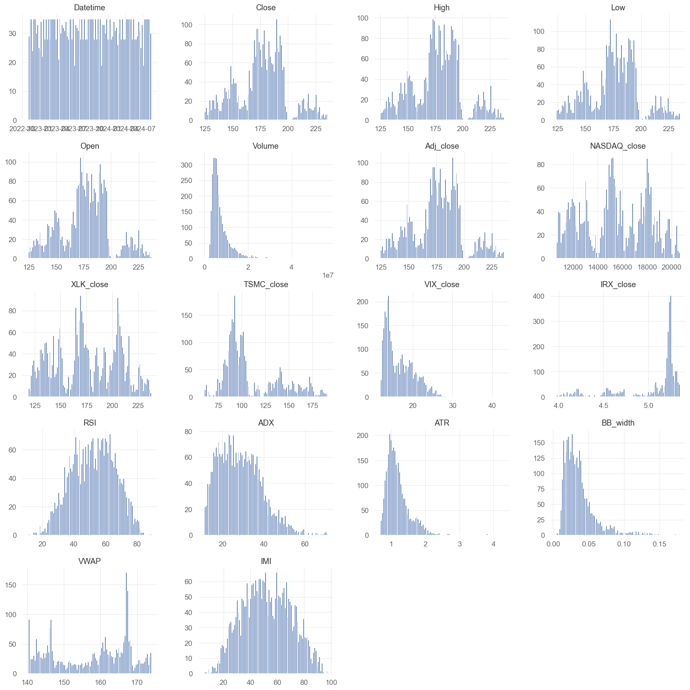
Exploratory Data Analysis
Exponential span
Non-normal distribution
Notes:
Next, I'll be presenting the exploratory data analysis (EDA) part.
First, in terms of feature distribution, we noticed that some variables have exponentially different spans and are not normally distributed. While machine learning models do not require normally distributed data as input, this insight suggests that further data processing is needed before modelling.

Slide 11
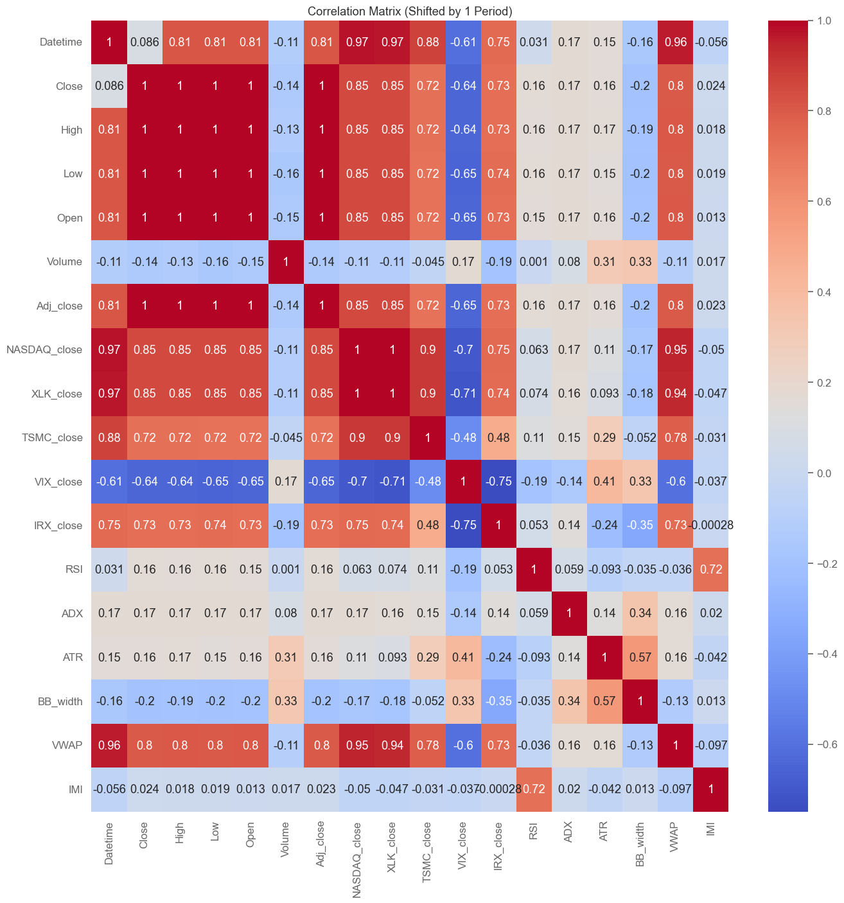
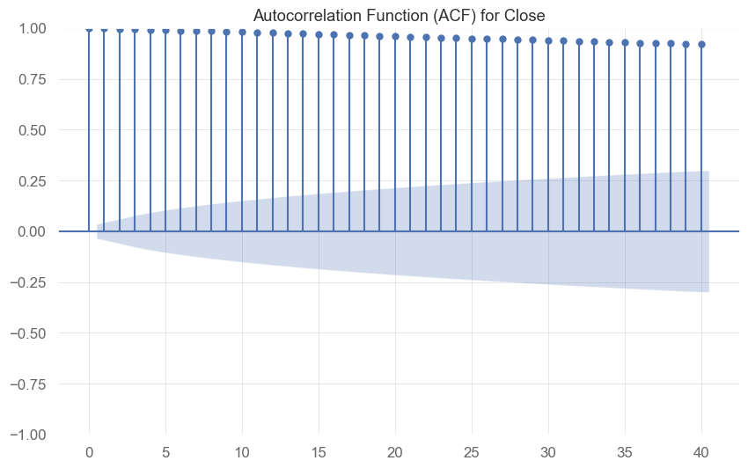
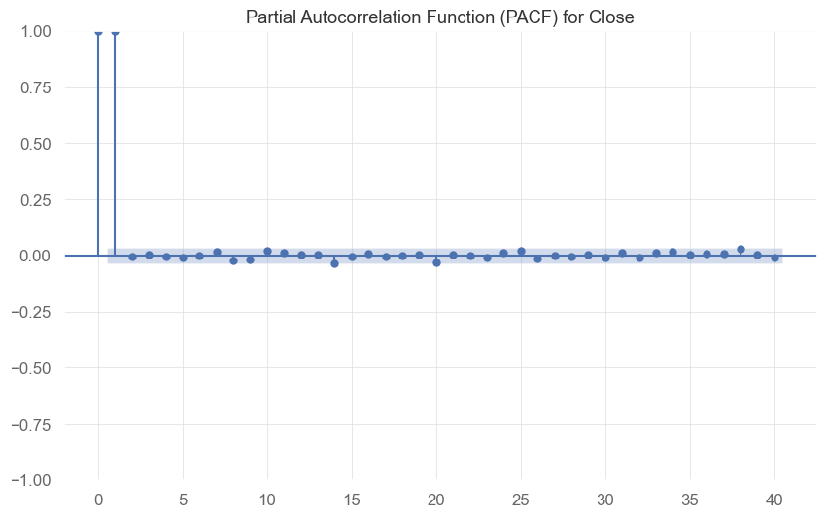
Exploratory Data Analysis
Notes:
In the correlation analysis where we shifted the 'Close' price by one period to better capture its relationship with other variables. Results showed multilinear correlations across original data, such as open, high, low, and adjusted close prices. Interestingly, most technical indicators had relatively weak correlations with the 'Close' price.
For autocorrelation, the 'Close' price demonstrated strong persistence across time, meaning the present price is closely linked to previous values. However, partial autocorrelation analysis hinted at non-stationarity.

Slide 12
Data Processing
Removed Variables:
Raw values ​​& variables with correlation > 0.95
Added Time-based Variables:
Hour_sin, Hour_cos, DayOfWeek_sin, DayOfWeek_cos
Final Variables:
'NASDAQ_close', 'XLK_close', 'TSMC_close', 'VIX_close', 'IRX_close', 'RSI', 'ADX', 'ATR', 'BB_width', 'VWAP', 'IMI', 'Hour_sin', 'Hour_cos', 'DayOfWeek_sin', 'DayOfWeek_cos'
Scaling:
RobustScaler
Validation:
Most recent 10% of training set
Notes:
With these insights, we selected model input variables that had correlations below 0.95 to avoid multicollinearity. Additionally, we incorporated time-based features—such as sin and cos transformations of the hour and day of the week—to capture cyclical patterns in the data.
Finally, before modelling, the data was also scaled using RobustScaler to handle the variability across features, and the training set was split, keeping the most recent 10% for validation purposes.

Slide 13
03 Models
ARIMA, LSTM, MoE

Slide 14
Model Oveview
1
ARIMA (Autoregressive Integrated Moving Average)
A time series forecasting model
2
LSTM (Long Short-Term Memory)
A type of recurrent neural network (RNN)
3
MoE (Mixture of Experts)
A machine learning model that divides a single task into subtasks using a gating mechanism

Slide 15
ARIMA Model
1
Stationarity Testing
An ADF test was conducted to check for stationarity:
p-value > 0.05 indicates non-stationarity
ADF statistic higher than critical values confirms non-stationarity
Model | ADF Statistic | P-value | Critical Values
 |  |  | 1% | 5% | 10%
Training Dataset | -0.71 | 0.85 | -3.43
ARIMA_1D | -20.42 | 0.0 | -2.86
ARIMA_2D | -10.11 | 1.01e-17 | -2.57

Slide 16
ARIMA Model
2
Initial Model Development
The initial ARIMA model inputs:
Closing prices
First-order differencing (d=1) was applied for stabilization.
The optimal ARIMA order determined was (0, 1, 0) by minimizing AIC.
3
Model Refinement
To enhance stability, second-order differencing (d=2) was applied:
This yielded an improved optimal order of (5, 2, 0).
The refined model (with d=2) was chosen as the final outcome due to better performance.

Slide 17
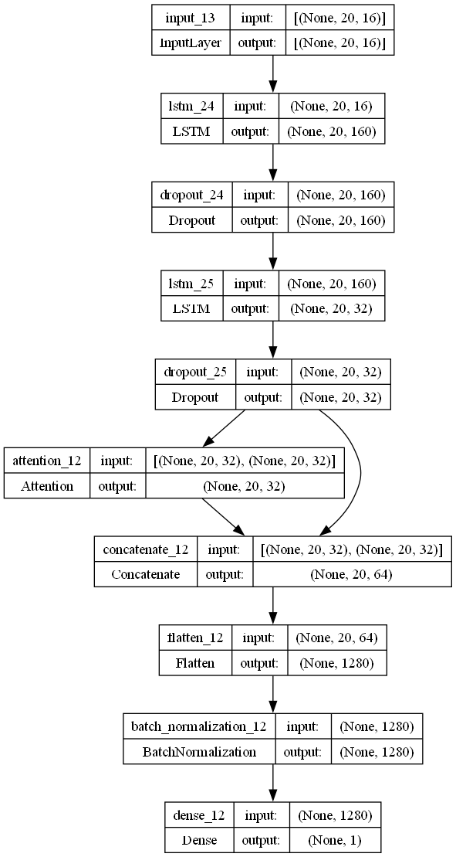
LSTM Model
1
Model Architecture:
Layers: Two recurrent neural network layers with dropout.
Normalization: Batch normalization to stabilize training
Attention Mechanism: Focus on key time steps
Optimization: Adam optimizer with cosine annealing for smoother convergence
Notes:
Hi I’m Xiying Huang. I’m also a data scientist in our group. Let me introduce LSTM and MoE model..
For LSTM, we built LSTM model based on the result from EDA.
About architecture, we used two recurrent layers with dropout and batch normalization to reduce overfitting. Then we added an attention mechanism to focus on key time steps, with the Adam optimizer with cosine annealing for smoother convergence.

Slide 18
LSTM Model
2
Hyperparameter Tuning
Name | Value
lstm_units | 160
lstm_units_2 | 32
dropout_rate | 0.1
lstm_look_back | 20
l2_reg | 0.0006
learning_rate | 0.003
batch_size | 16
Tool Used: Keras Tuner with Bayesian Optimization
Parameters Tuned: LSTM units, dropout rates, L2 regularization, learning rate
Notes:
Finally, we used Keras Tuner for hyperparameter tuning, and here is the result of Hyperparameter Optimization.

Slide 19
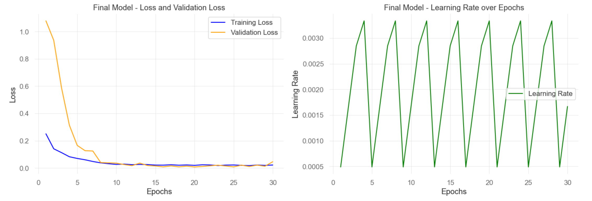
LSTM Model
3
Model Testing and Evaluation
Testing Process: Full training dataset with callbacks for early stopping
Evaluation: Inverse transform predictions for accuracy against actual prices
Notes:
Then we tested the model with early stopping to refine predictions.

Slide 20
MoE Model
1
Gating Network Mechanism:
Additional LSTM Layer: Captures temporal dependencies to adapt to data changes
Blending Weights: Two dense layers with softmax activation, constrained between 20% and 80% for balanced influence.
Notes:
For MoE model, our MoE model blends ARIMA and LSTM predictions using a gating network that considers market volatility. Specially, we added an extra LSTM layer, it captures time-based patterns, making it more responsive to changes.
And there are two dense layers set balanced weights, constraining weights between 20% and 80%.

Slide 21
MoE Model
2
Training Process:
Real-Time Adjustment: Gating network sed actual stock prices as targets to adjust weights.
Momentum Smoothing: Applied for smoother transitions in weight values across forecasts
Notes:
The gating network adjusts these weights in real time based on actual stock prices, and also momentum smoothing ensures smooth and stable transitions in our forecasts.
That’s all about our predict techniques, thank you!

Slide 22
04 Results
Model Evaluation and Financial Performance

Slide 23
Model Evaluation
Key Metrics:
MSE: Mean Squared Error
RMSE: Root Mean Squared Error
MAPE: Mean Absolute Percentage Error
ARIMA
Limited gains in accuracy, despite increased complexity.
LSTM
A trade-off between accuracy and computational demand
MoE
Viable alternative for scenarios where both accuracy and efficiency are required.
Model | MSE | RMSE | MAPE(%) | Training Time(s)
ARIMA | 30.87 | 5.56 | 1.98 | 0.19
LSTM | 4.06 | 2.01 | 0.67 | 48.54
MoE | 7.89 | 2.81 | 0.99 | 11.17

Slide 24
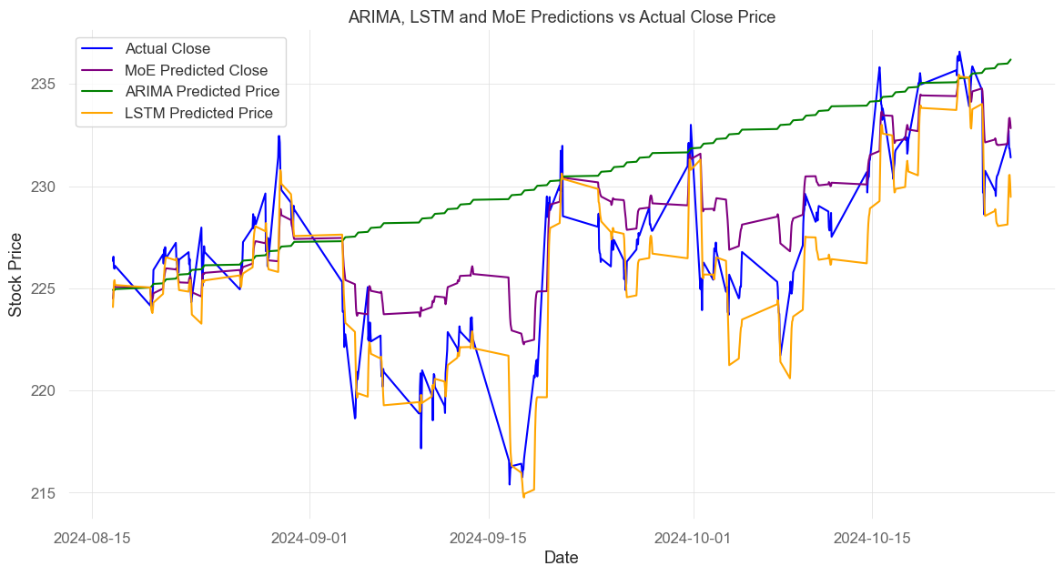
Model Evaluation
Summary:
LSTM provides the most accurate predictions
MoE suitable for robust prediction with moderate computational demands
ARIMA optimal for rapid, broad trend analyses but may lack the precision necessary

Slide 25
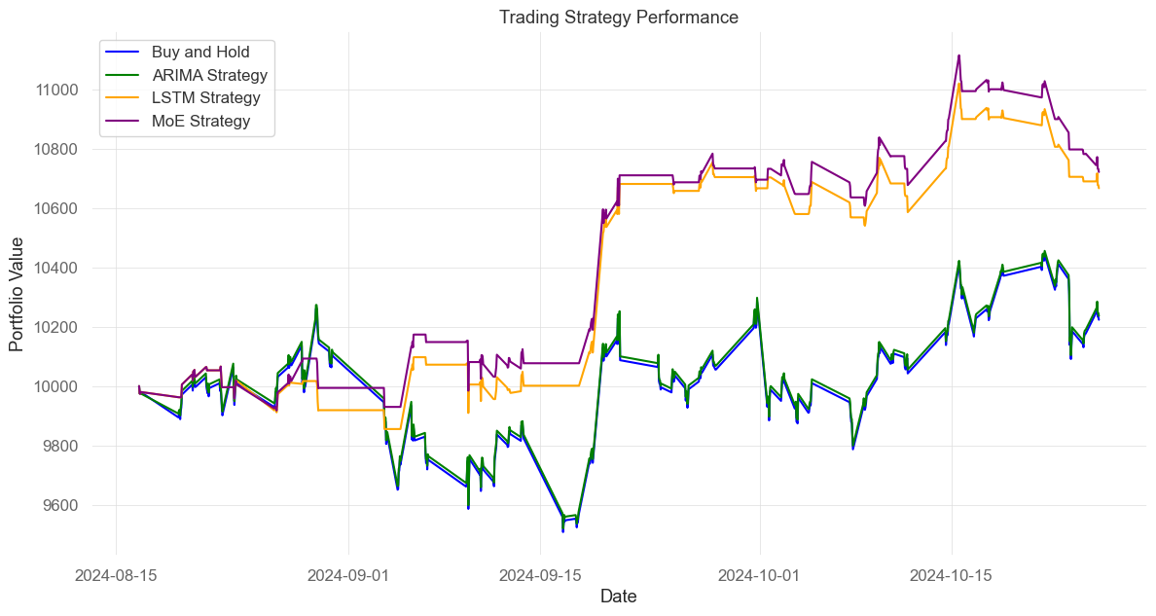
Financial Performance
Trading Strategy:
Executing a buy order
If the model predicts a price increase the following day.
Executing a sell order
If a price decrease is forecasted.

Slide 26
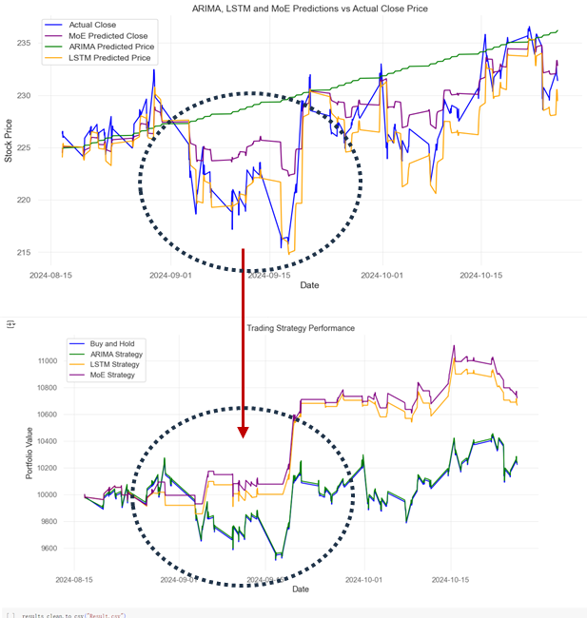
Financial Performance
On Sept. 15—Apple‘s product launch event：as a critical time marker for examining model performance.
Prior-Event Performance Result:
ARIMA(green line): Struggled to adapt to short-term changes, missed the downward trend.
LSTM & MoE(orange and purple) : Accurately identified the downward trend, effectively reduced losses.

Slide 27
Financial Performance
Performance Result:
Post-Event Performance: All models showed portfolio value growth, capturing positive price movements.
Conclusion: LSTM and MoE outperformed ARIMA in real-time responsiveness and around key events, supporting more effective trading and portfolio growth.

Slide 28
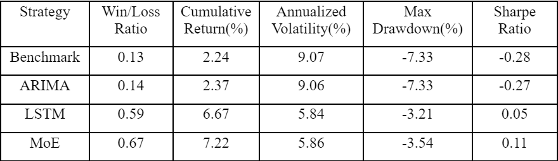
Financial Performance
Backtesting and Metrics:
MoE model
Outperforms in cumulative returns, highest Sharpe Ratio.
synthesize various forecasting advantages
LSTM model
Significant strengths, substantial returns, comparatively high Sharpe Ratio, minimal drawdown
leverage sequential dependencies
ARIMA model
Lower overall returns,more cautious performance.
Overall: machine learning models demonstrate a higher sensitivity to short-term fluctuations and a capacity for rapid adaptation.

Slide 29
05 Conclusion
Investment Recommendations,

Slide 30
Investment Recommendations
MoE Strategy
Effective for active investors seeking to maximize returns, manage risk through data-driven trading decisions.
LSTM Model
Balancing substantial returns, lower volatility suitable for those desiring both growth and strong risk control.
ARIMA Model
Identifying broader market trends long-term price movements, economic cycles, shifts influenced by macroeconomic indicators.
.

Slide 31
Investment Recommendations
Above all,
Buy and Hold strategy may be appropriate for conservative investors,
though forfeits potential gains observed in model-driven approaches.
Diversified investment strategy combining MoE and LSTM models, can optimize returns while addressing market risks.

Slide 32
Thanks for Watching!

